Slide 1
Training summary

Slide 2
Agenda
Cloud Computing
Web logic
Spring Boot
Eclipse IDE
Tuxedo
Jenkins
Docker
Implementation Output

Slide 3

Introduction to cloud

Slide 4
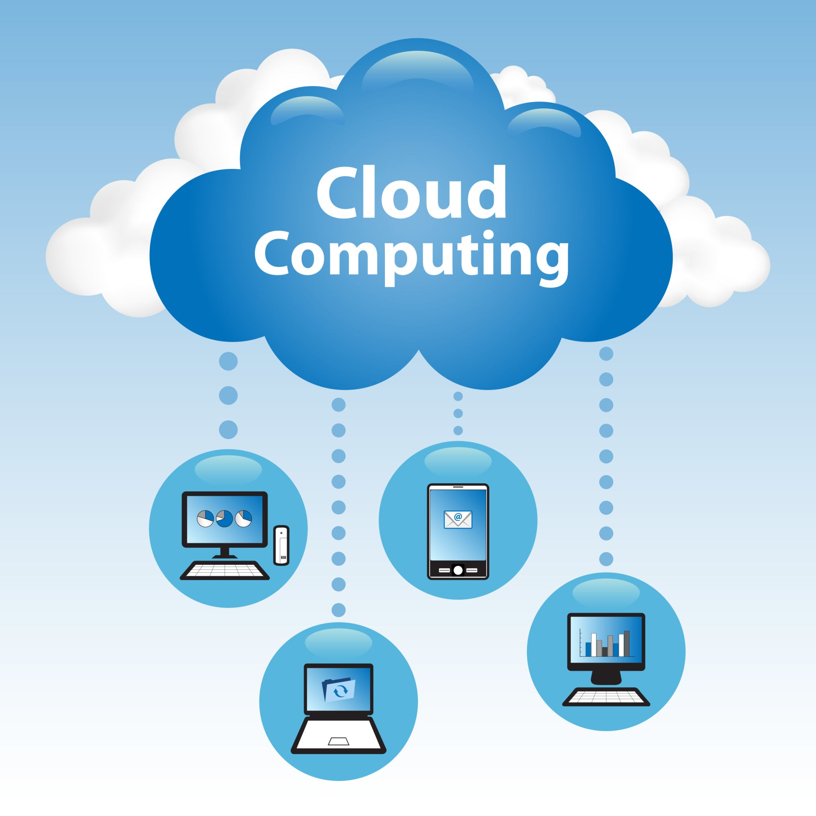
What is cloud
The term cloud refers to a network or the internet.
It is a technology that uses remote servers on the internet to store, manage, and access data online rather than local drives.
The data can be anything such as files, images, documents, audio, video, and more.

Slide 5
Operations USING CLOUD
Developing new applications and services
Storage, back up, and recovery of data
Hosting blogs and websites
Delivery of software on demand
Analysis of data
Streaming videos and audios

Slide 6
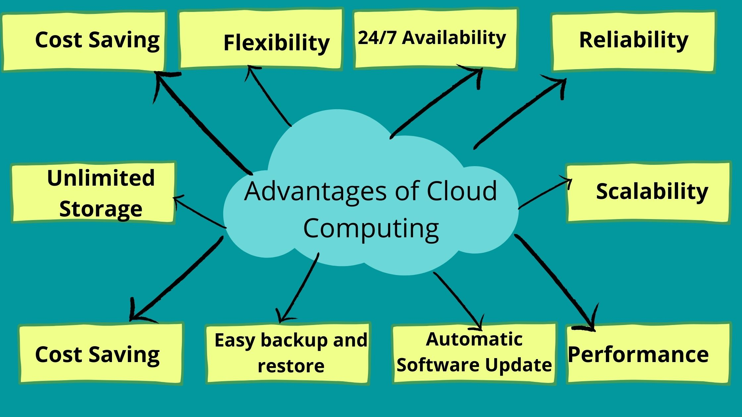
ADVANTAGES OF CLOUD
Data Backup and Restoration
Improved Collaboration
Excellent Accessibility
Cost-effective Maintenance
Upkeep and Updates
Mobility
Pay-per-use Model
Scalable Storage Capacity
Enhanced Data Security
Disaster Recovery and Business Continuity
Agility and Innovation

Slide 7
Web logic

Slide 8
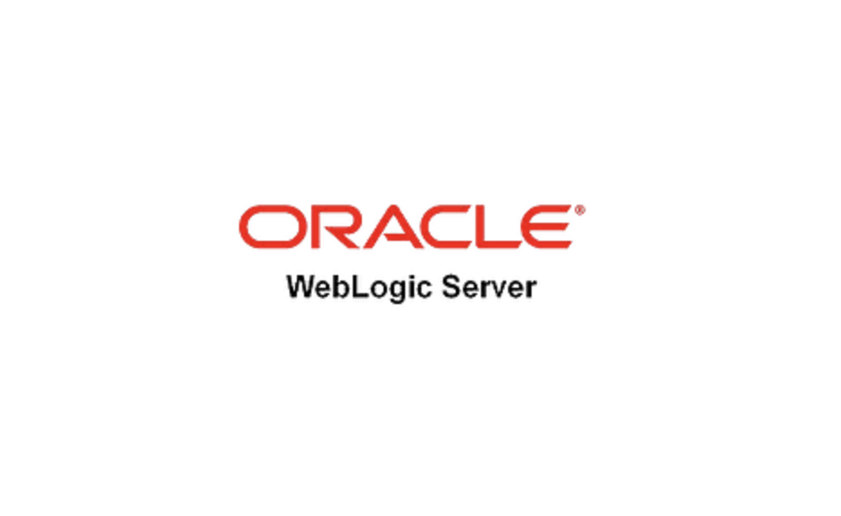
​
Introduction to WebLogic
WebLogic Server is a Java EE application server for building and deploying enterprise applications.
Developed by Oracle Corporation, it's widely used for large-scale, distributed applications.
Supports multi-tiered architectures and offers integration with Java-based technologies like EJB, JMS, JPA, and Servlets.

Slide 9
Use Cases
Large-scale Enterprise Applications: Suitable for banking, healthcare, and retail applications.
Integration Platforms: Connects disparate systems across an enterprise.
Cloud Applications: Supports hybrid cloud deployments with integration capabilities.
Deployment Options:-
Cloud Ready: Deployable on on-premise, Oracle Cloud, and third-party cloud platforms.
Docker & Kubernetes: WebLogic can be deployed in containers for modern cloud-native architectures.
Zero Downtime Deployment: Rolling upgrades and versioning allow for uninterrupted service.

Slide 10
Spring Boot

Slide 11
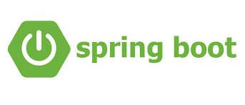
Introduction to Spring Boot
Spring Boot is an open-source framework designed to simplify the development of Java applications.
It is part of the Spring Framework ecosystem, and it provides a fast, efficient, and flexible way to build production-ready applications with minimal configuration.
Spring Boot allows developers to create stand-alone, production-grade applications with ease, focusing on simplicity, speed, and ease of use.
It eliminates the need for complex configurations, making it particularly popular in building microservices and cloud-native applications.

Slide 12
Use Cases
Microservices: Ideal for building RESTful APIs and microservices-based applications.
Enterprise Applications: Quickly build enterprise-grade applications with minimal setup.
Cloud Applications: Designed for deployment in cloud environments like AWS, Azure, and Google Cloud.
Serverless: Works well with serverless computing platforms (e.g., AWS Lambda).
Core Components
Spring boot starter :Pre-configured templates for commonly used functionality.
Spring Boot Actuator:Provides production-ready features like monitoring, health checks, and metrics.
Spring Boot CLI: Command-line interface for quickly running and testing Spring Boot applications.
Spring Boot DevTools: Tools for improving the development experience, such as live reload and auto-restart.

Slide 13

Eclipse IDE

Slide 14
Introduction to Eclipse IDE
Eclipse IDE is an open-source, integrated development environment primarily used for Java development, but it supports other programming languages through plugins.
Known for its extensibility and strong support for enterprise-level applications.
Widely used for building Java applications, web development, mobile apps, and embedded systems.
Eclipse IDE for Different Purposes
Eclipse for Java Developers: Includes Java Development Tools (JDT) to streamline Java application development.
Eclipse for Web Developers: Provides support for HTML, CSS, JavaScript, and web frameworks like Spring, JSF, and Struts.
Eclipse for Mobile Development: Support for Android development (via Android Development Tools plugin) and other mobile platforms.
Eclipse for Embedded Development: Tools and plugins for embedded system development, including C/C++ support.

Slide 15
Tuxedo

Slide 16
Introduction to Tuxedo
Tuxedo is a middleware platform from Oracle used to build and manage large-scale, distributed, and transaction-oriented enterprise applications.
Primarily designed to support transaction processing (TP) applications, message-driven services, and enterprise service buses (ESBs).
Supports multi-platform environments, including UNIX, Linux, and Windows.

Slide 17
JENKINS

Slide 18
What is Jenkins?
Open-source automation server used for continuous integration (CI) and continuous delivery (CD).
Supports building, testing, and deploying code in a repeatable and efficient manner.
Written in Java, widely used in software development for DevOps pipelines.
How Jenkins Works
Source Code Management: Integrates with version control systems (e.g., Git, SVN).
Build Triggers: Can be triggered by code changes, scheduled builds, or manual initiation.
Automated Testing: Runs unit tests, integration tests, and other quality checks.
Continuous Delivery: Deploys code to test or production environments.

Slide 19
Jenkins Use Cases
CI/CD Automation: Automates the process of integrating code changes and deploying them.
Test Automation: Runs automated tests to ensure code quality.
Monitoring: Tracks builds, deployments, and test results in real time.
DevOps: Bridges the gap between development and operations teams with streamlined workflows.

Slide 20
Docker

Slide 21
What is Docker?
Open-source platform for automating the deployment, scaling, and management of applications in containers.
Enables developers to package applications and their dependencies into a portable container that can run consistently across different environments.
Uses OS-level virtualization to create lightweight, isolated environments for running applications.

Slide 22
Docker Workflow
Write Dockerfile: Define the application environment and dependencies.
Build Image: Use docker build to create an image from the Dockerfile.
Run Container: Use docker run to create and start a container from the image.
Share Image:Push images to Docker Hub or private registries for sharing and reuse.
Deploy and Scale: Deploy containers to servers or cloud environments; scale horizontally by running more instances.

Slide 23
Implementation output

Slide 24
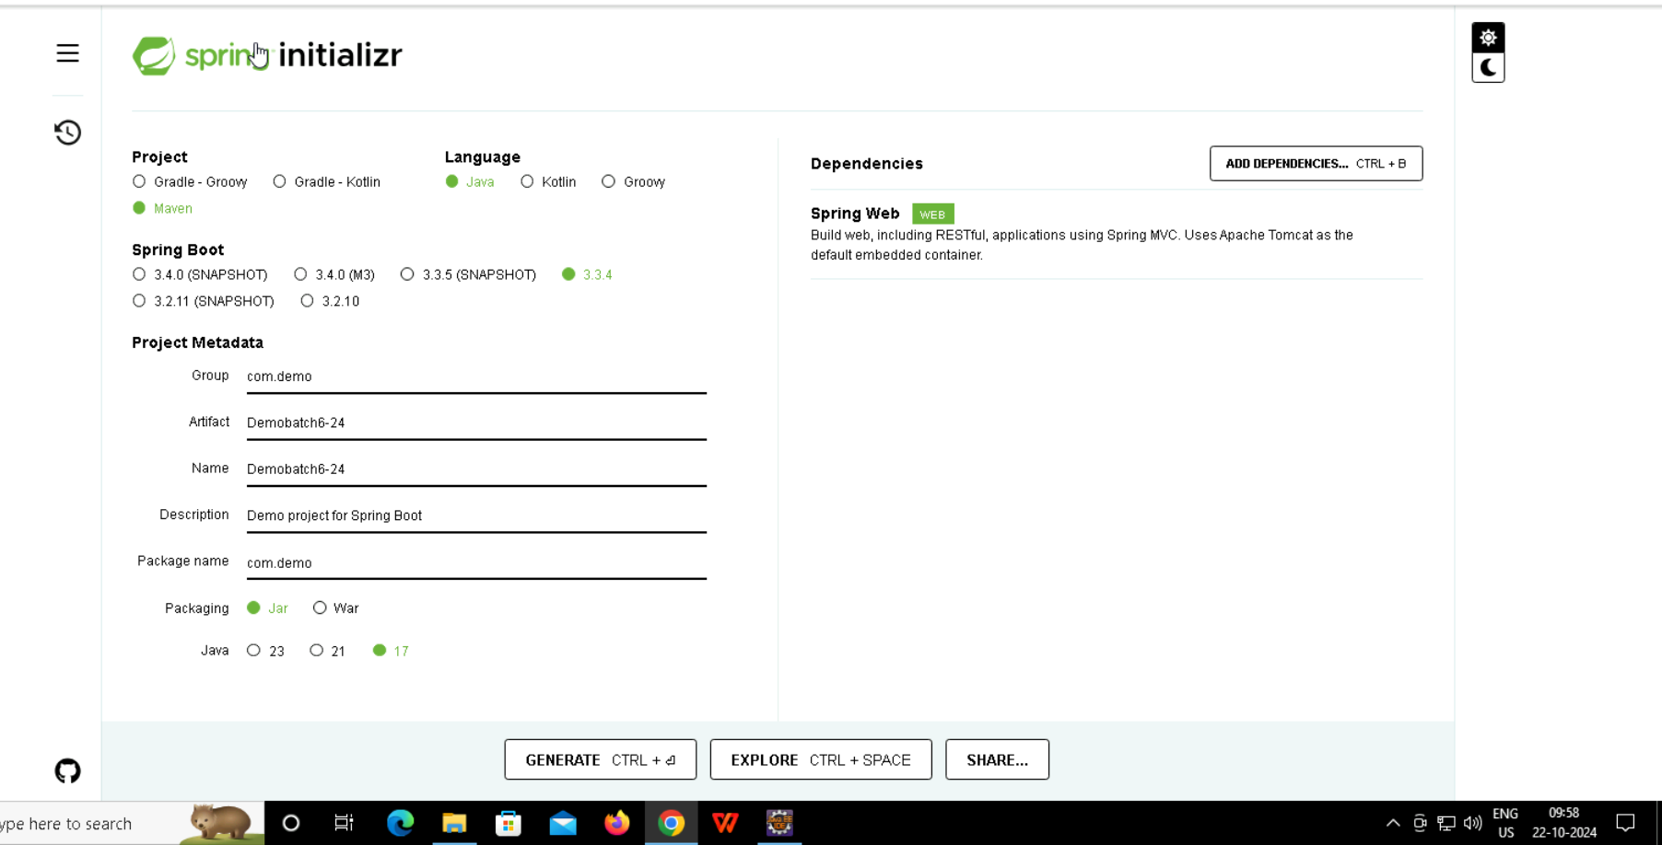
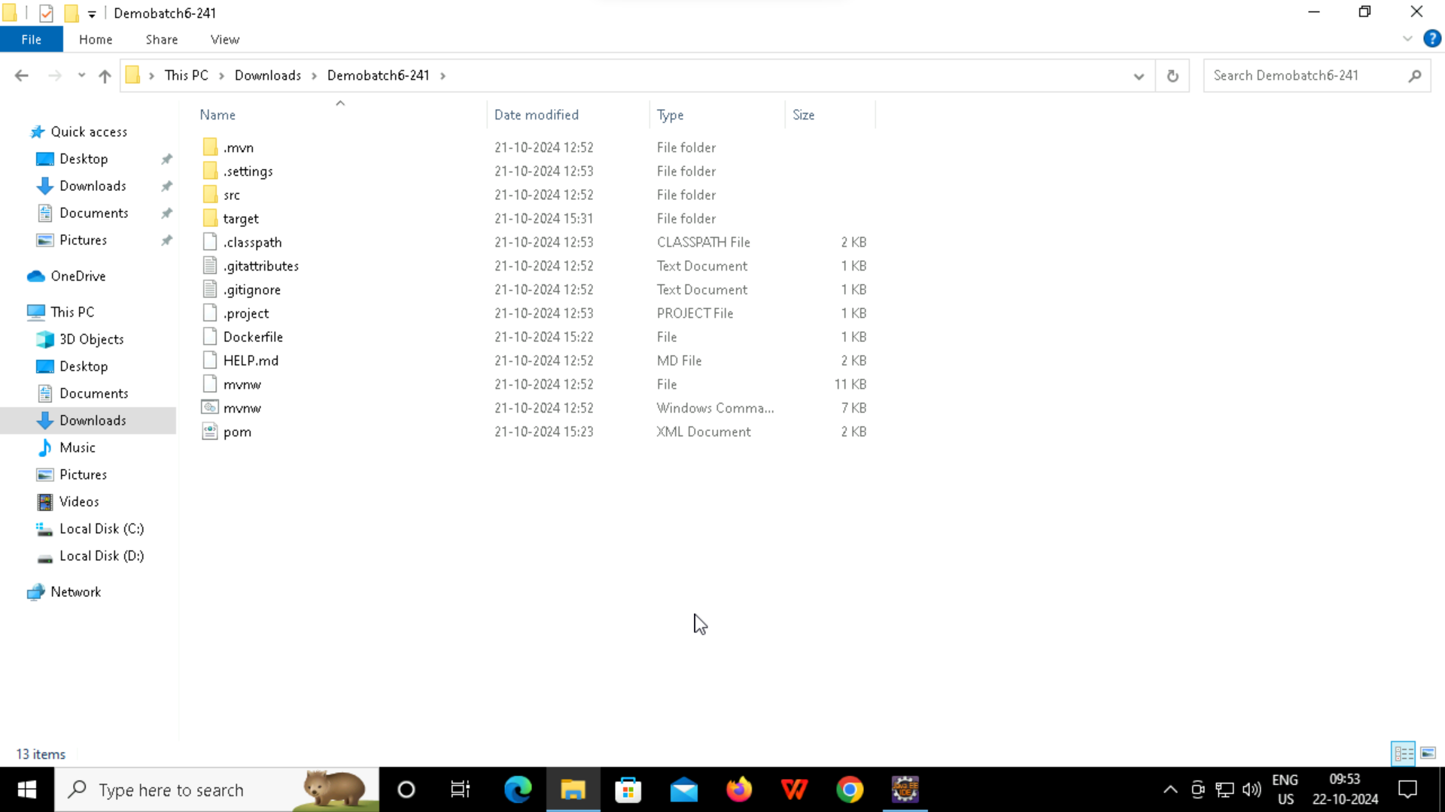

Slide 25
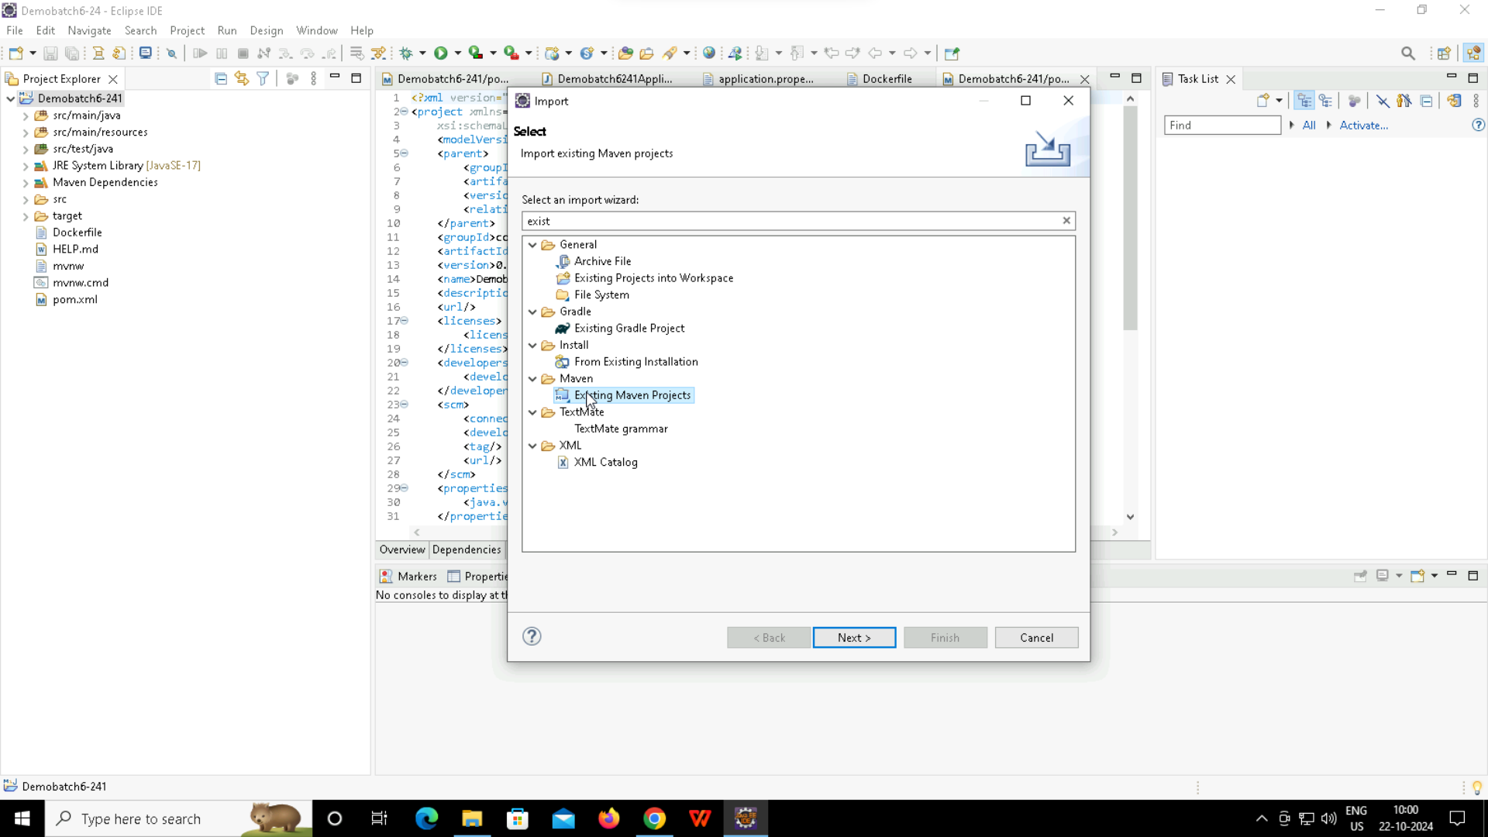
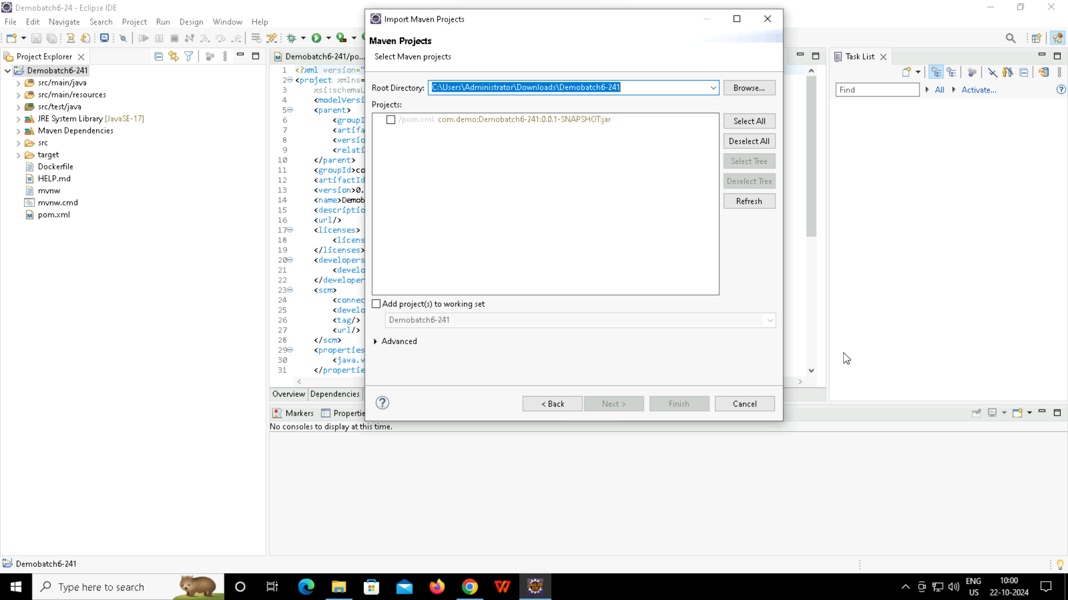

Slide 26
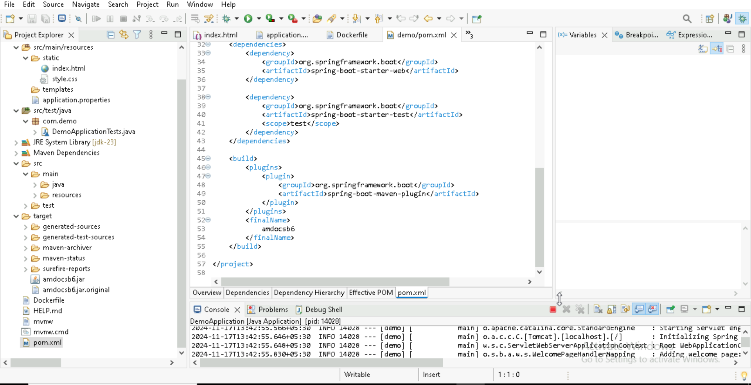
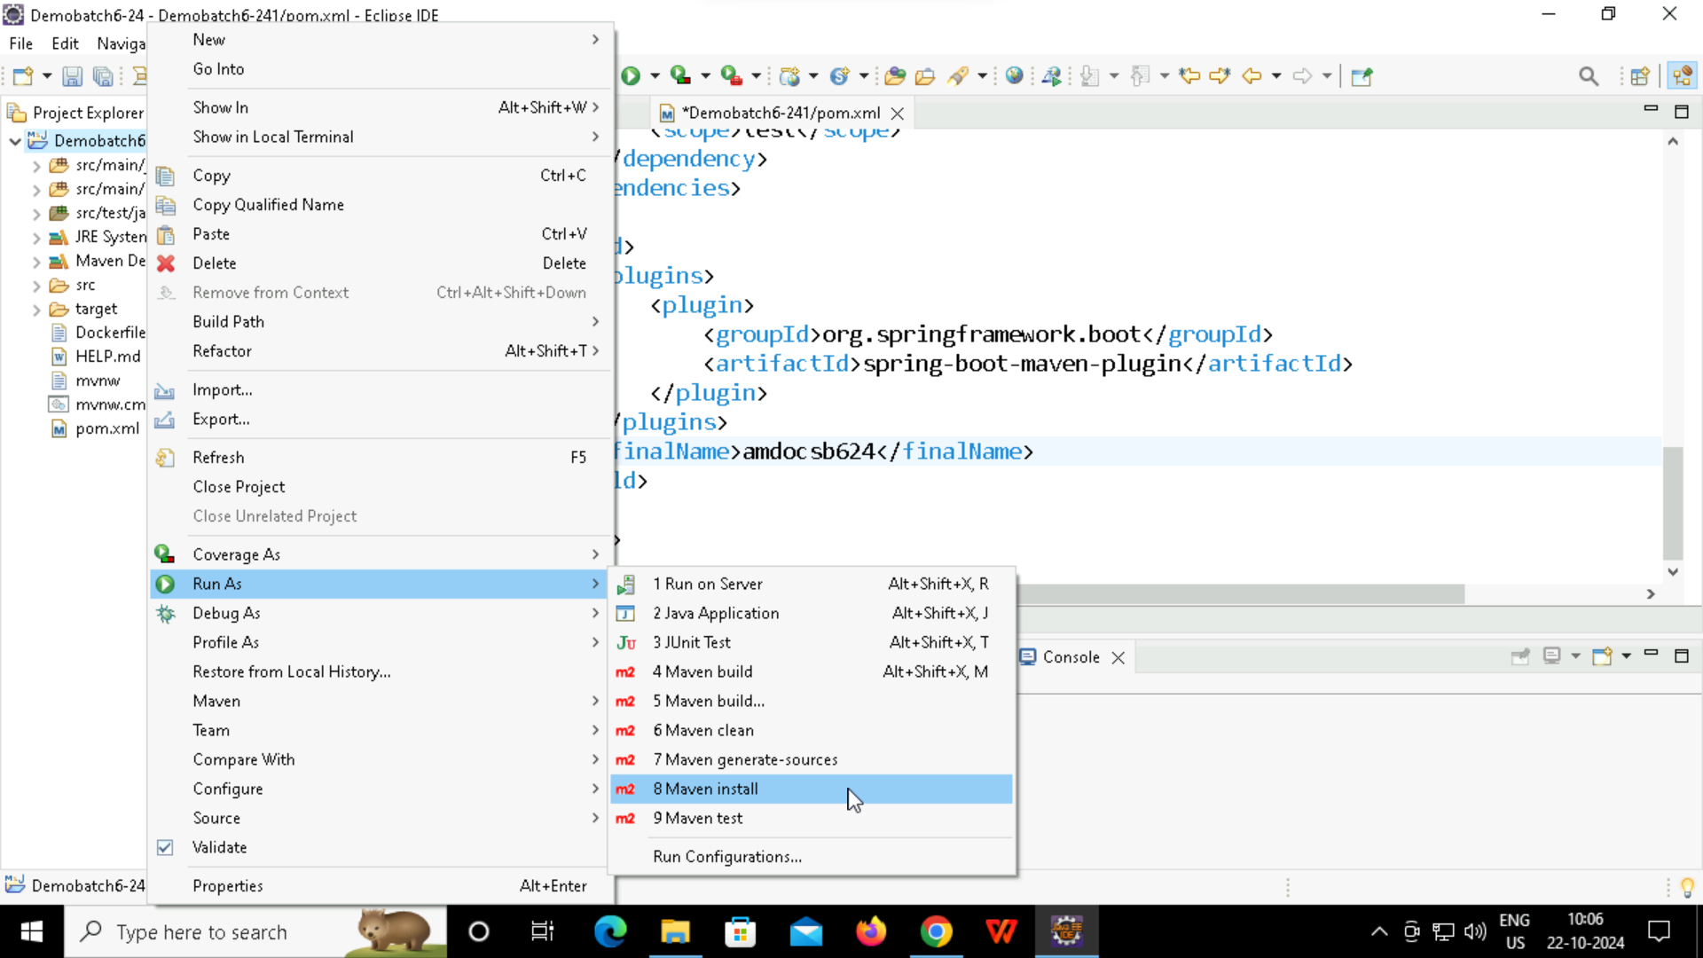

Slide 27
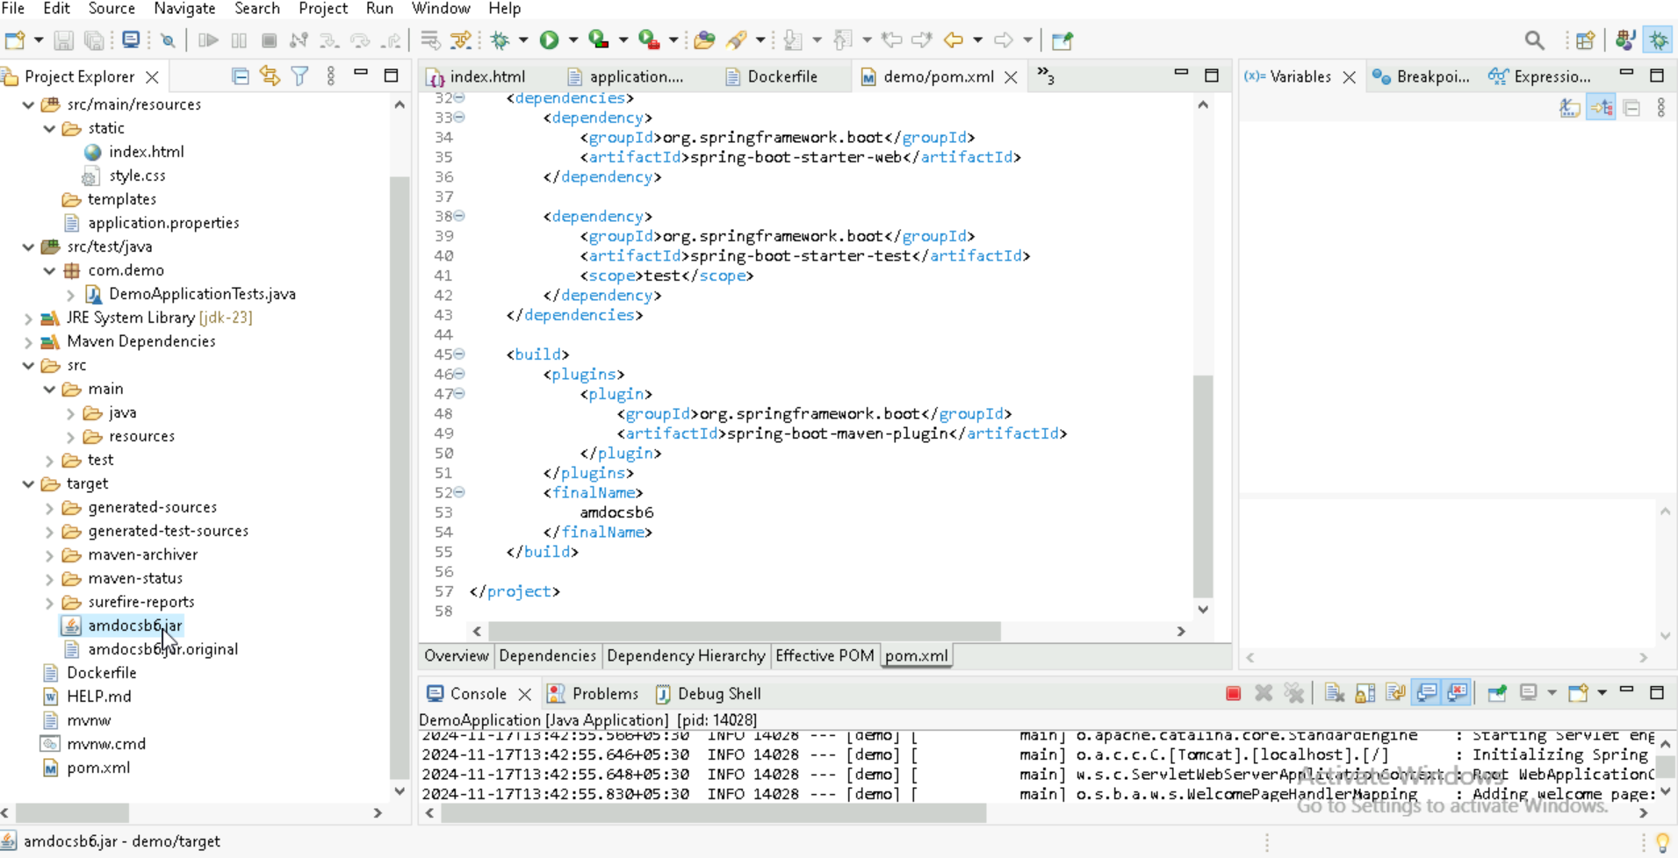
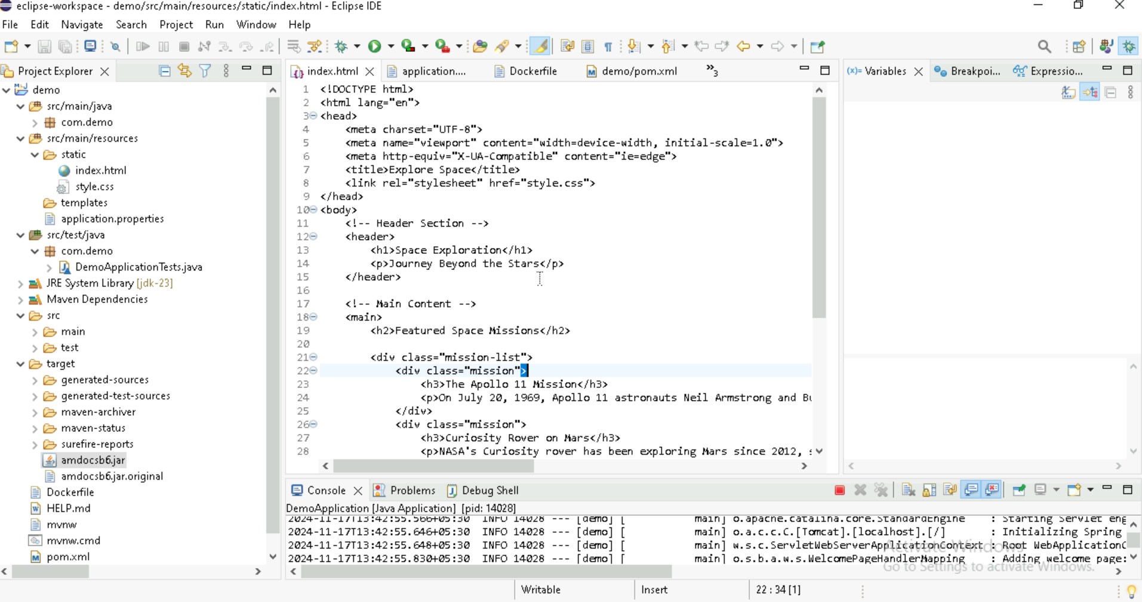

Slide 28
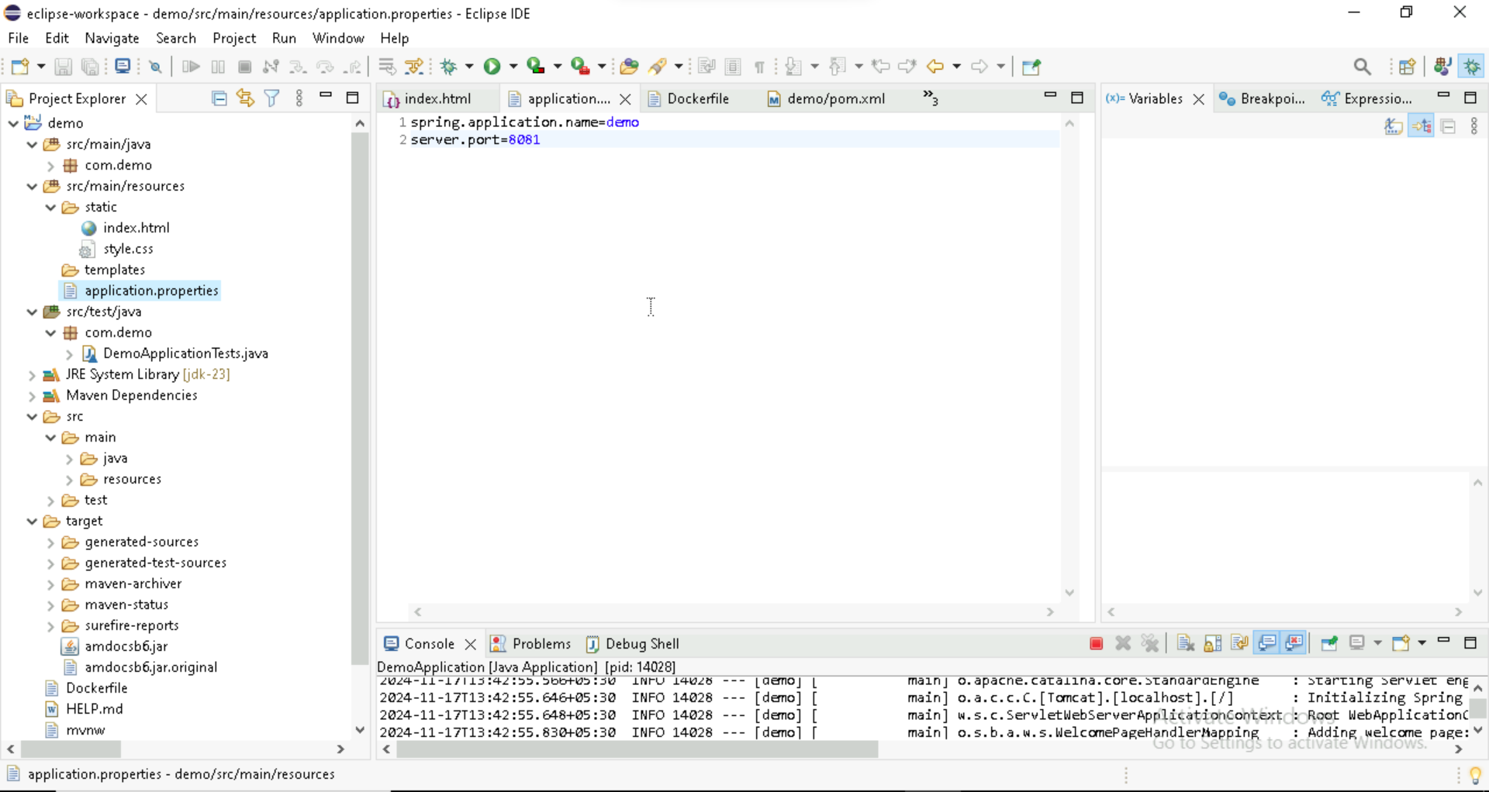
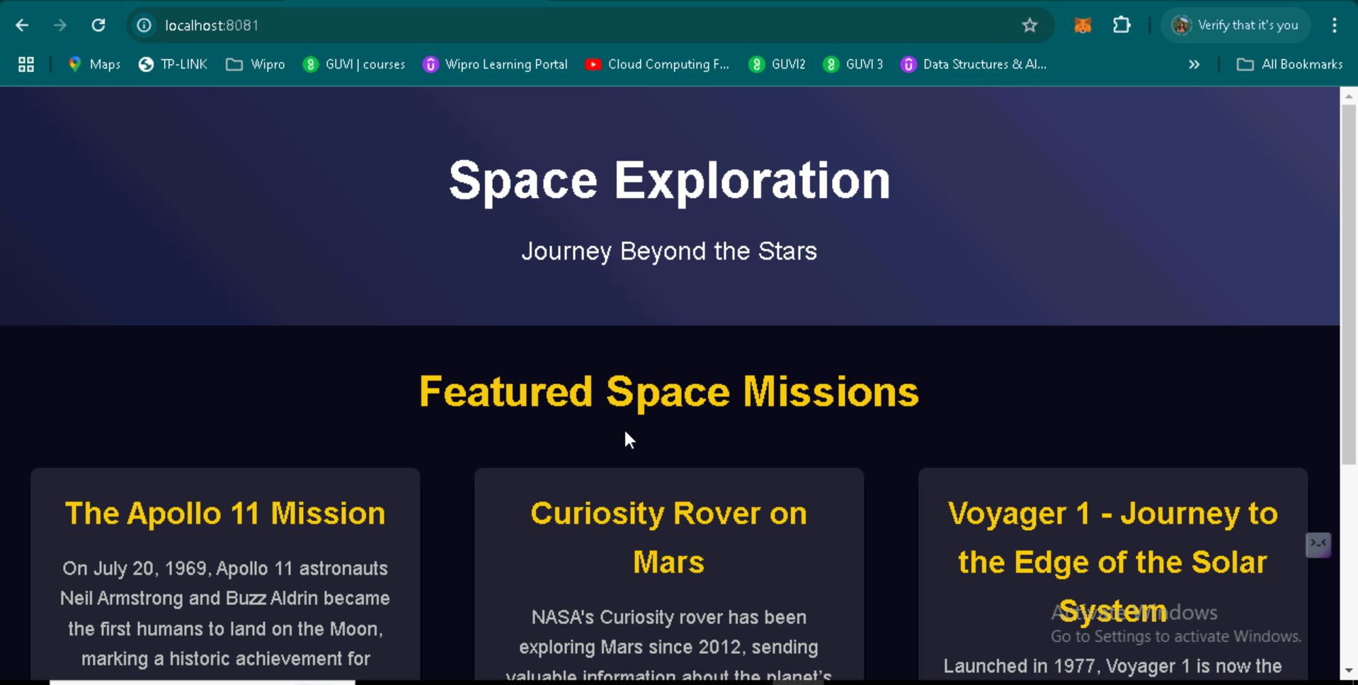

Slide 29
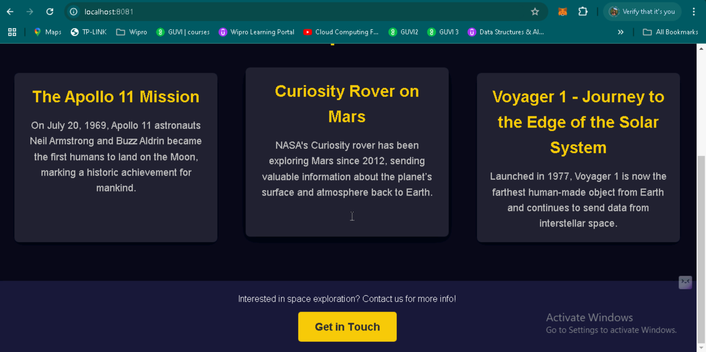

Slide 30
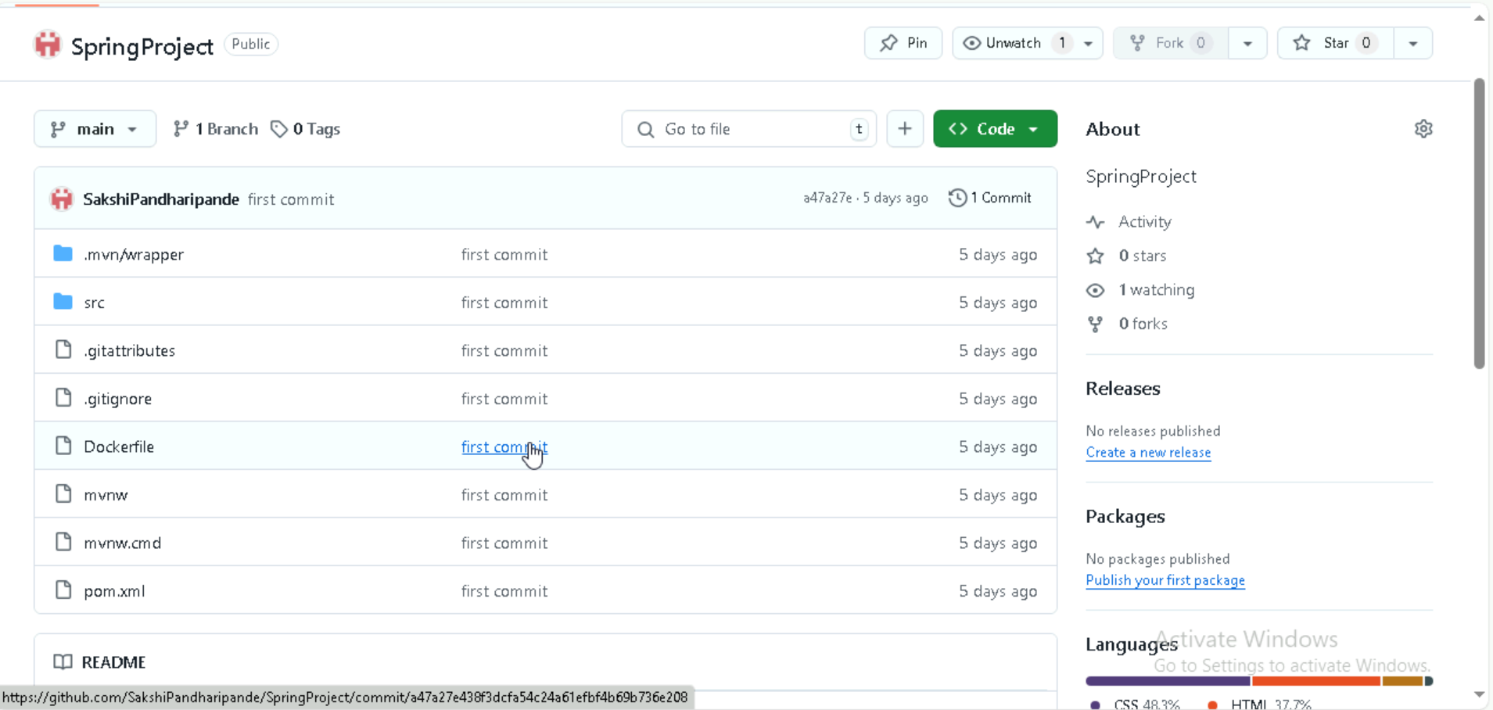
Git Commands
git init
git config --global user.name “SakshiPandharipande”
git config --global user.name sakshipandharipande72249@gmail.com
git status
git add .
git status
git commit -m “first commit”
git bracnch -M main
git remote add origin gitrepositoryurl
git push -u origin main

Slide 31
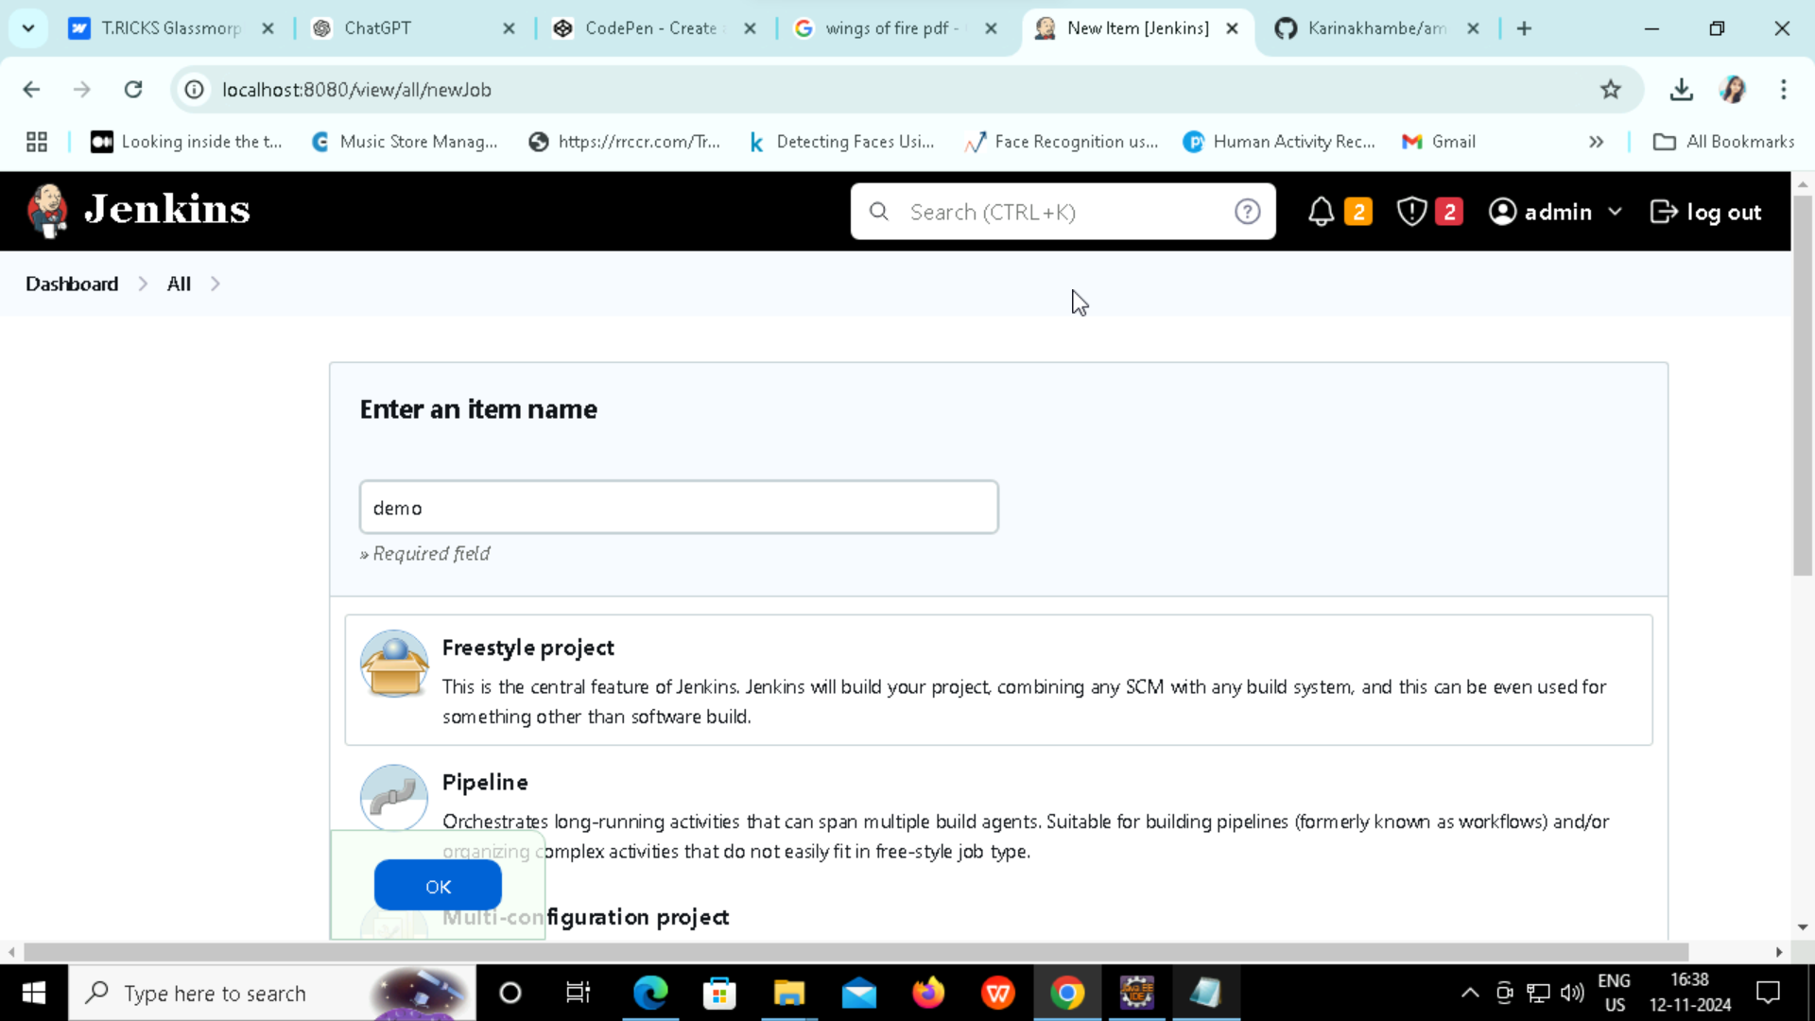
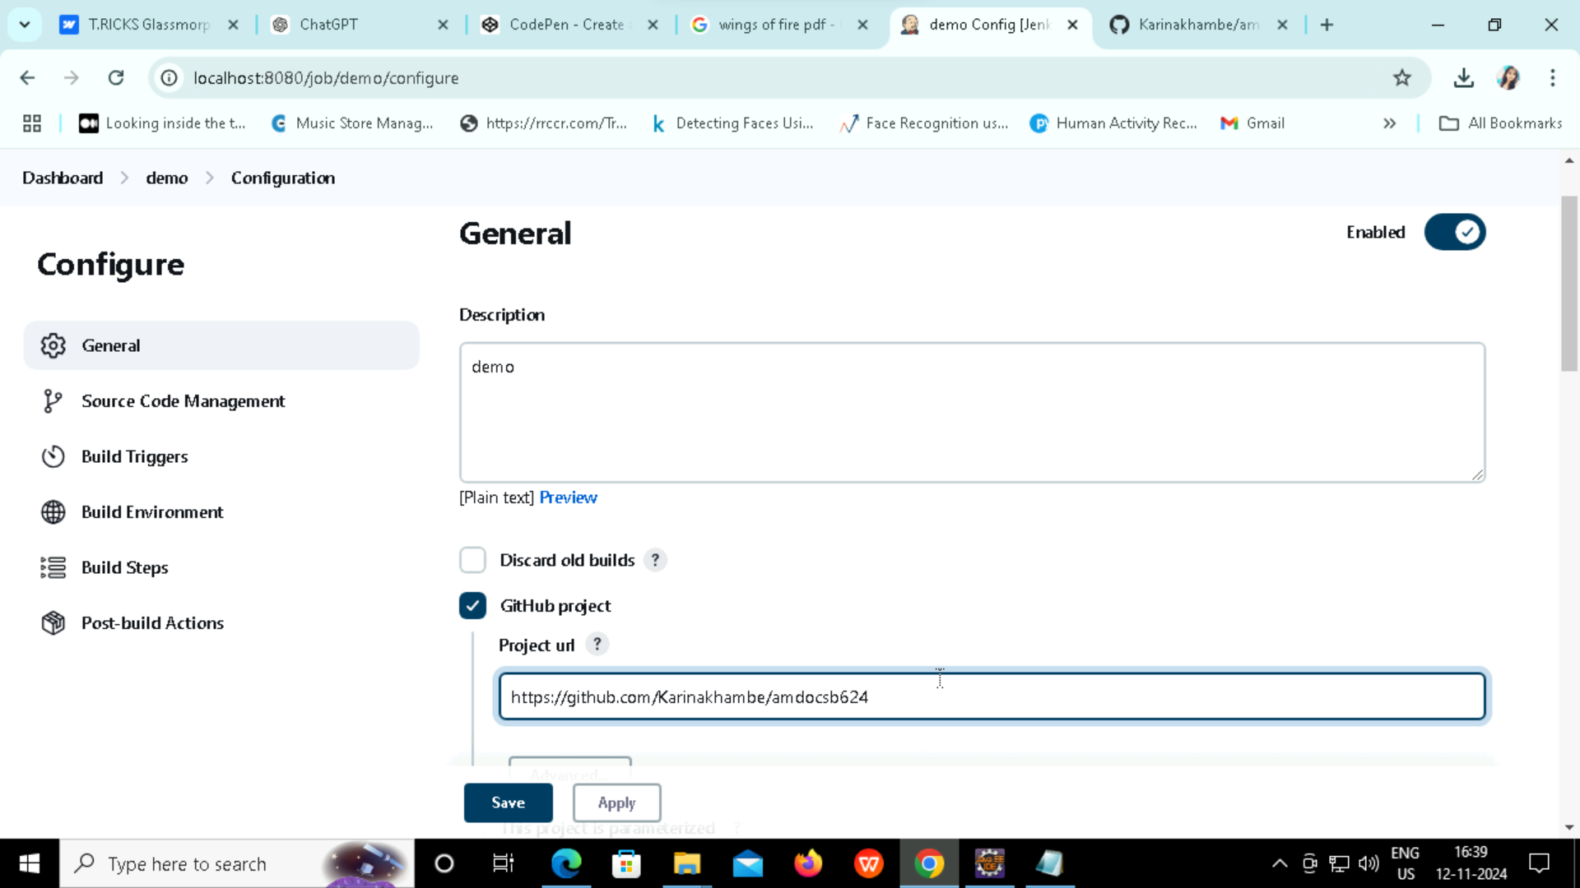

Slide 32
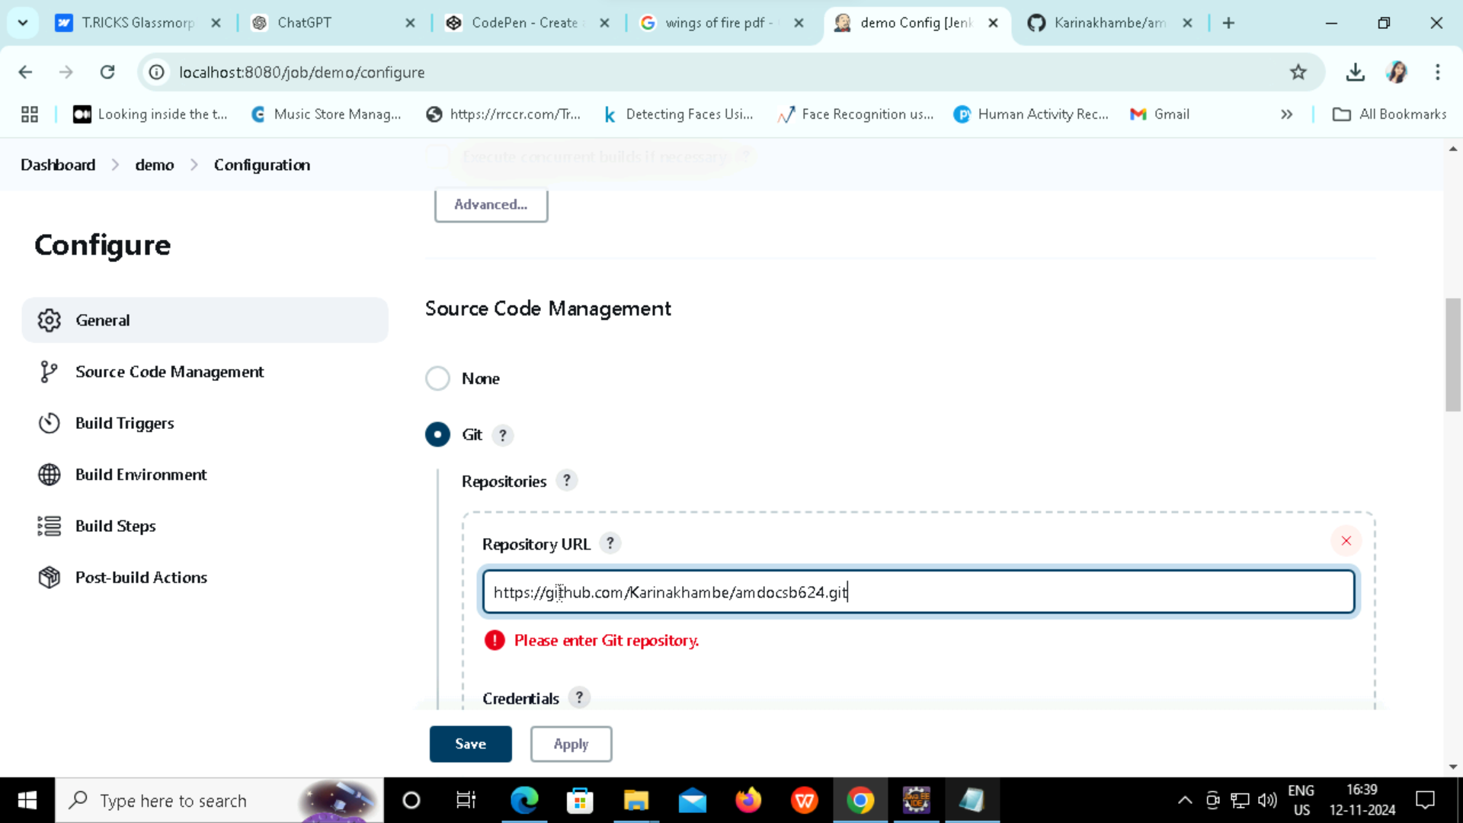
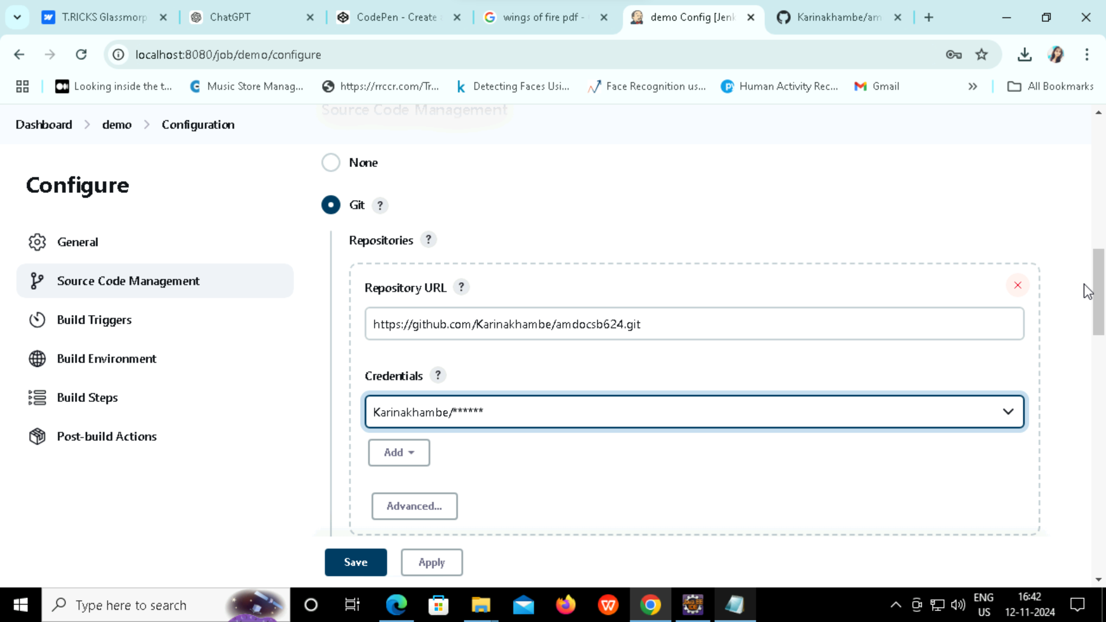

Slide 33
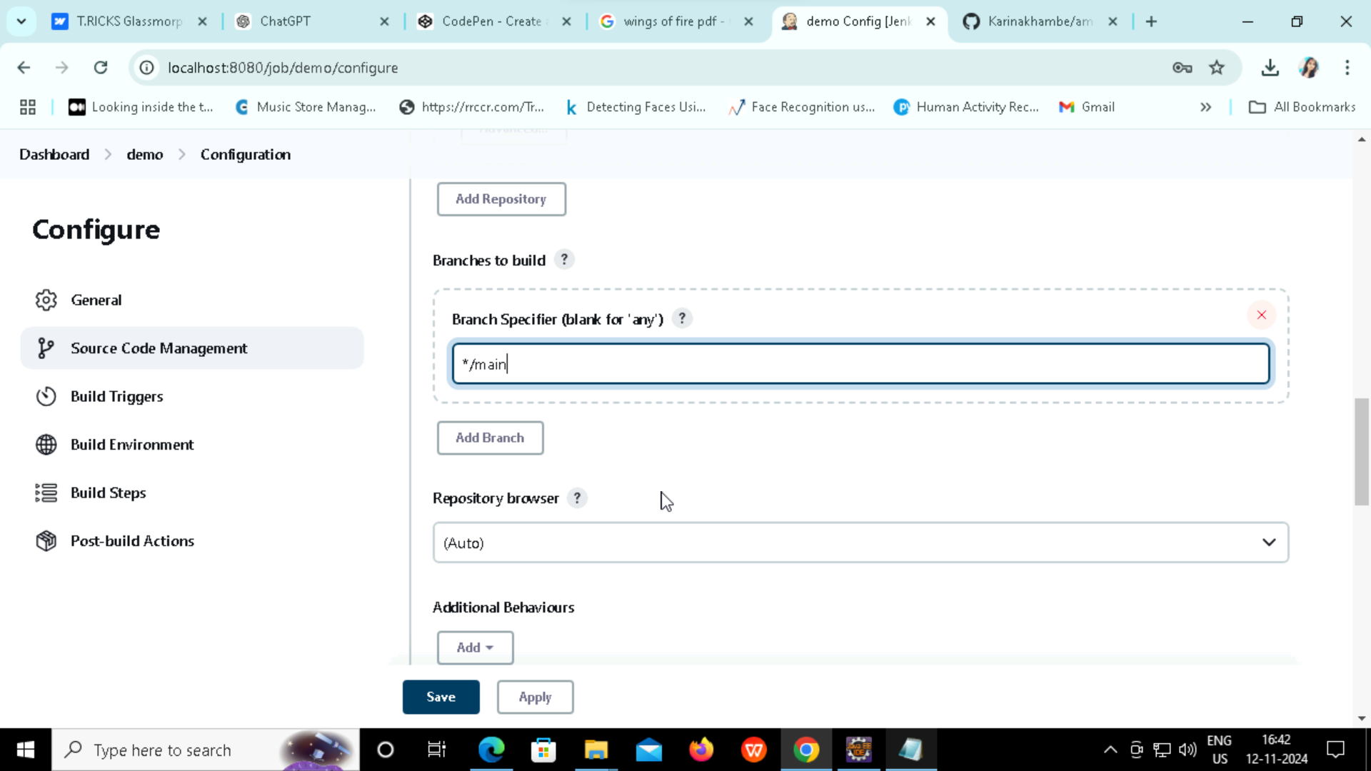
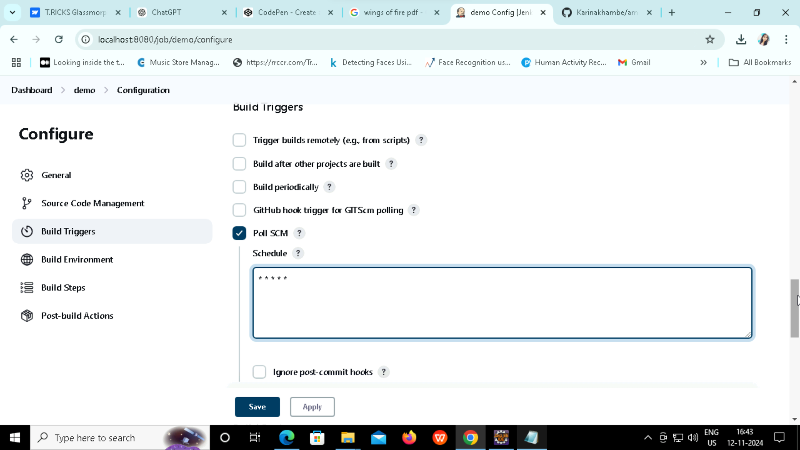

Slide 34
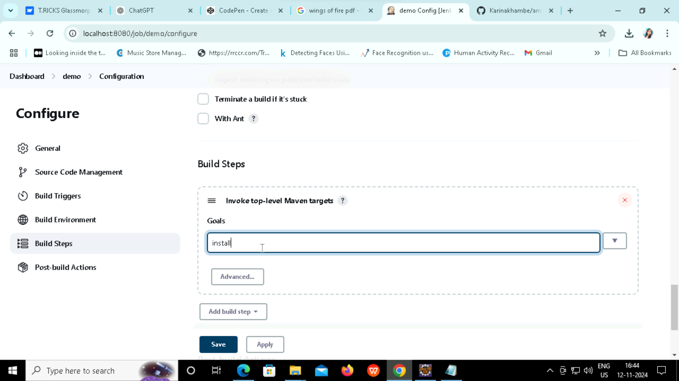
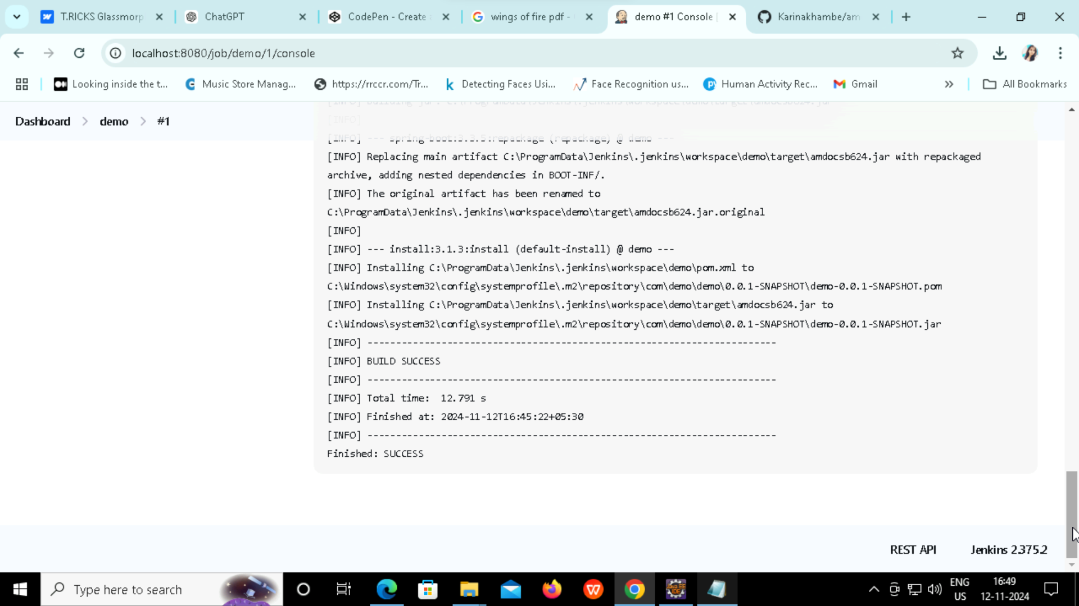

Slide 35
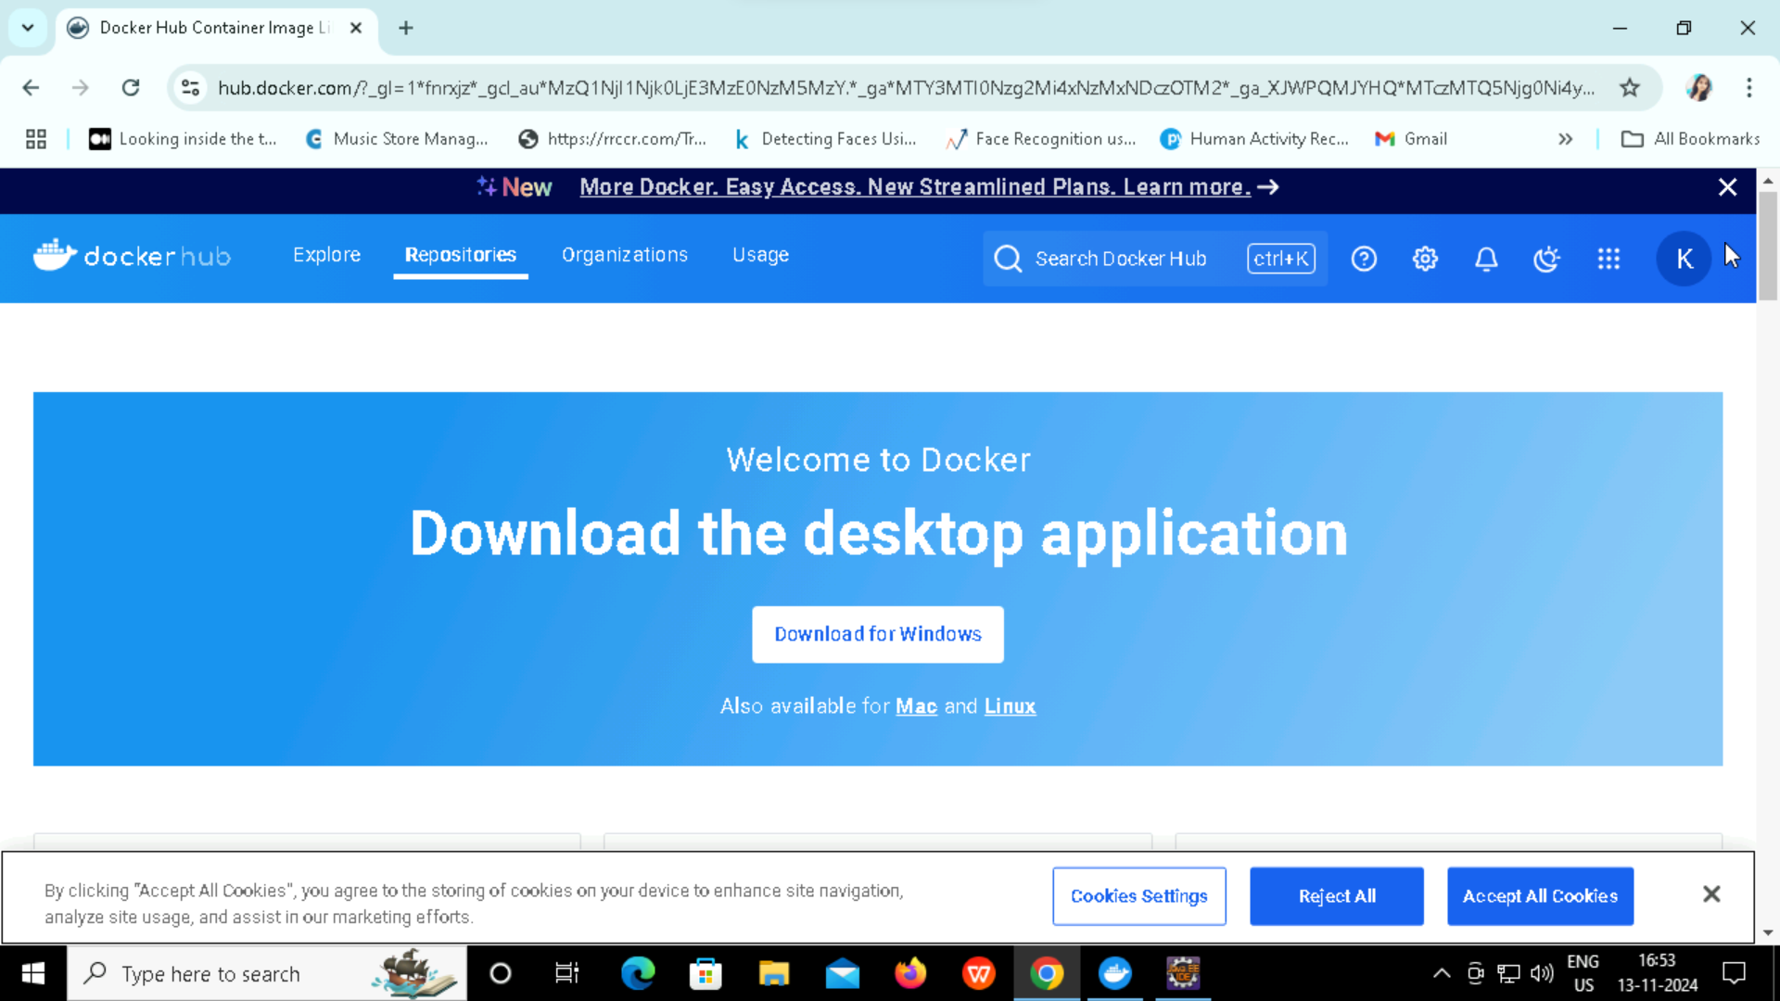
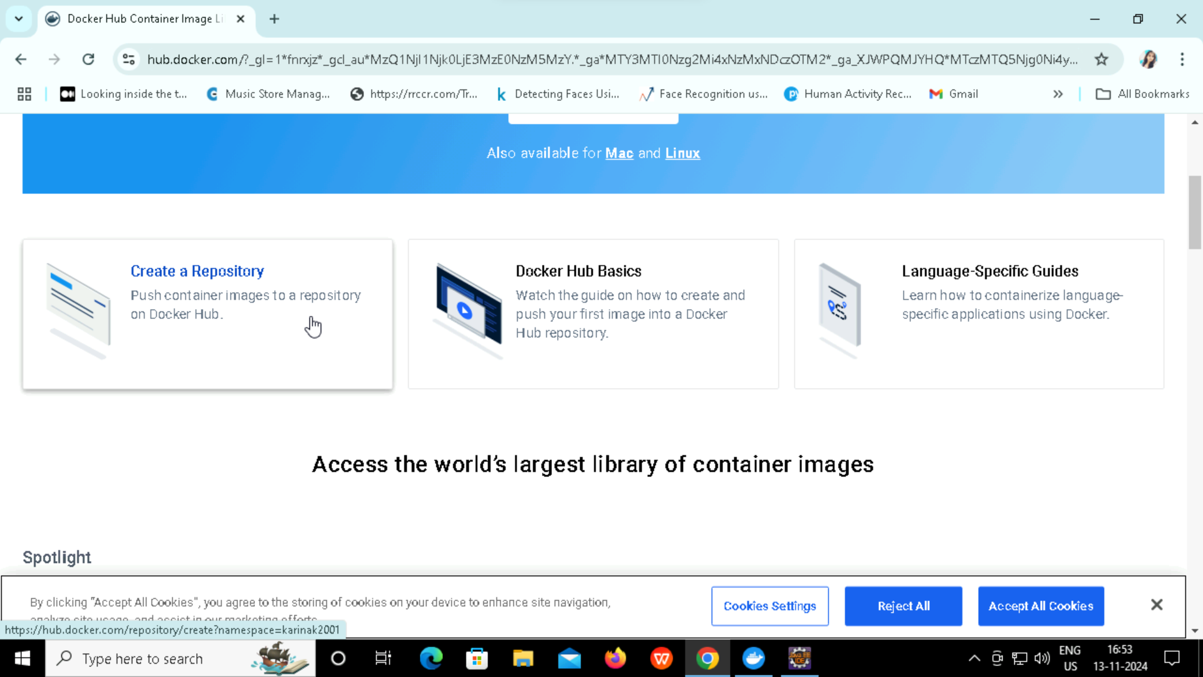
Creating a Tag and Docker Repository

Slide 36
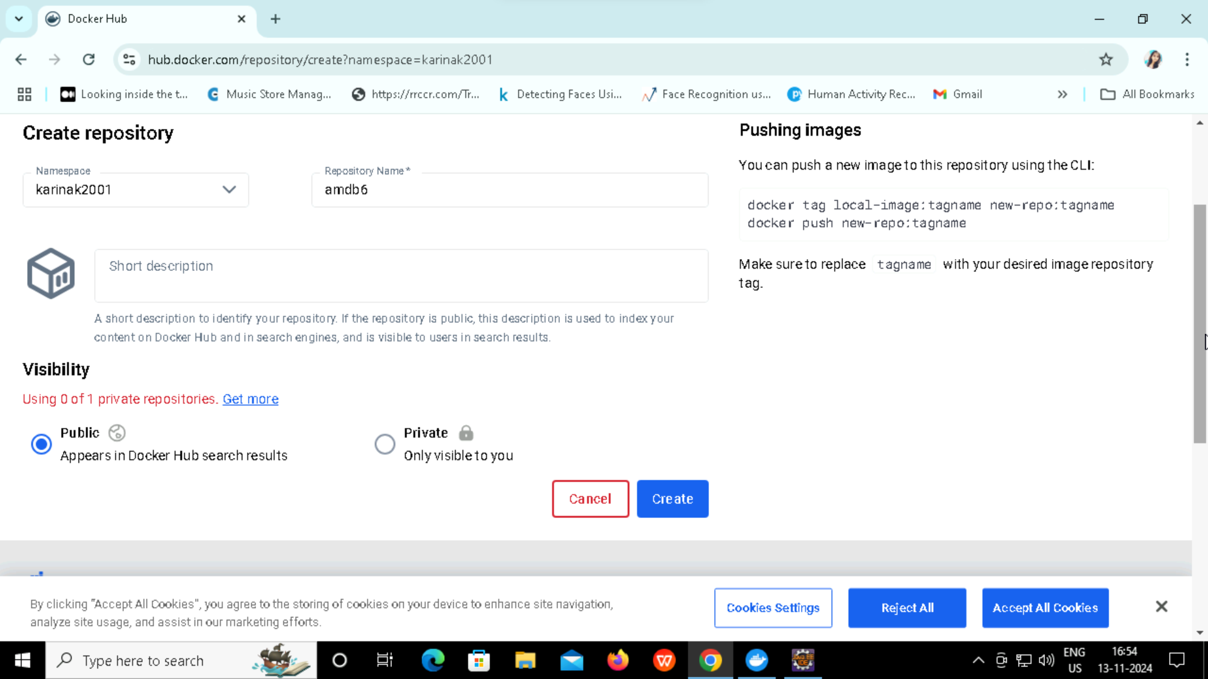
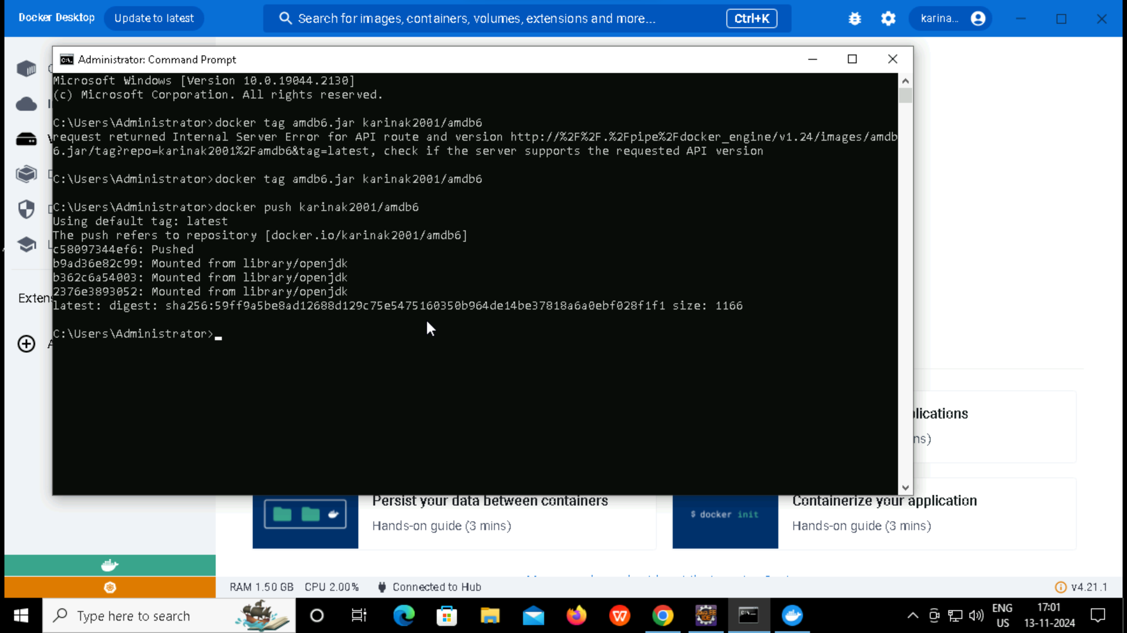
Create a Tag inside a normal command prompt

Slide 37
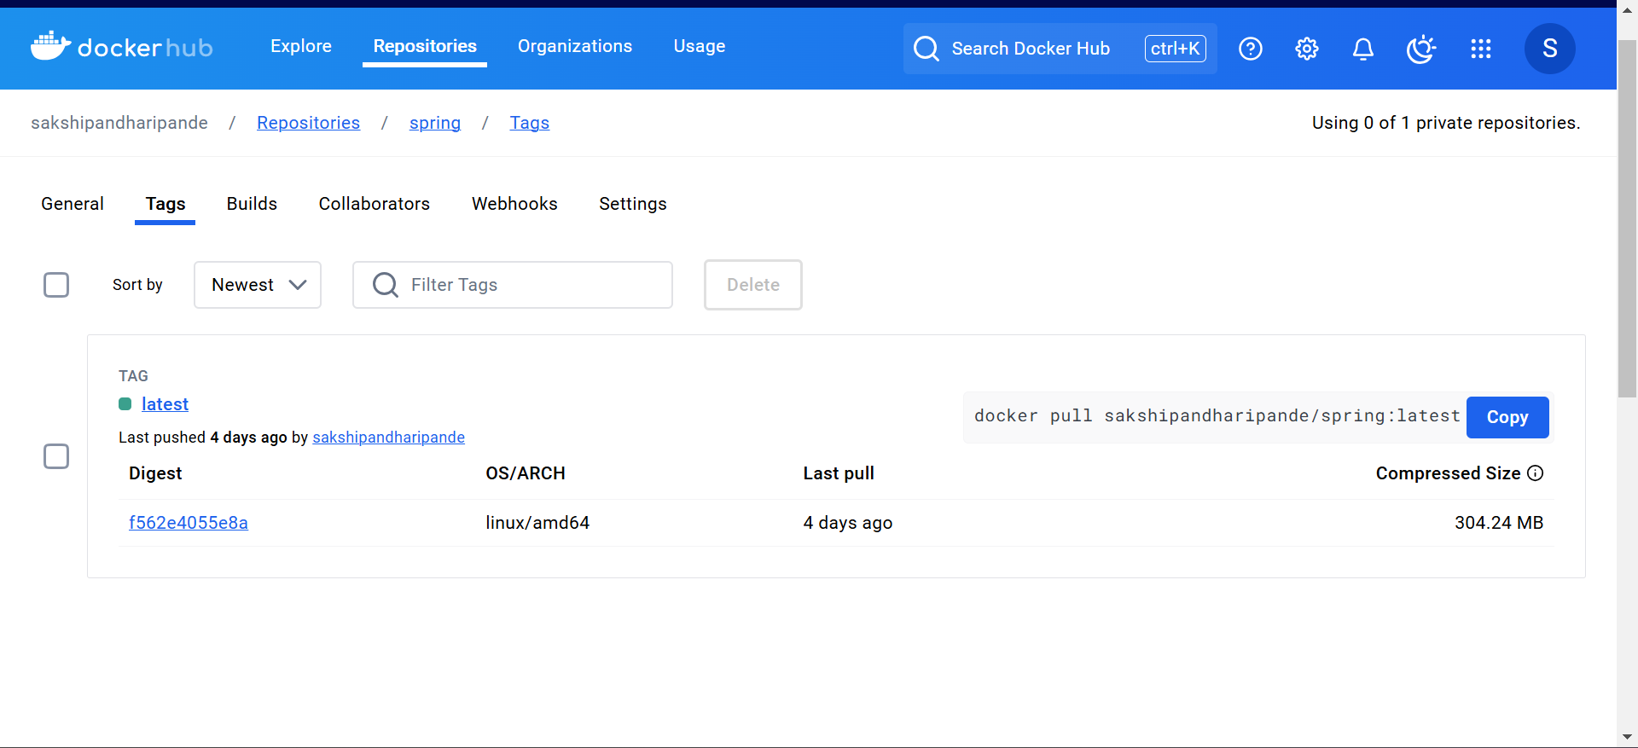
After creating a tag check it on docker hub -> Repository -> Tags

Slide 38
THANK YOU

